Slide 1


India All-Star Training: Python - File Handling
28.03.2023
Sridhar Mahamkali & Rajesh Shendre

Slide 2
Introduction
File handling is an important aspect of programming, as it allows you to work with external files and data.
Python provides built-in functions and modules for file handling, making it easy to read from and write to files.
Common file formats include text files, binary files, and CSV files.

Slide 3
Steps in Data File Handling
OPENING FILE
We should first open the file for read or write by specifying the name of file and mode.
PERFORMING READ/WRITE
Once the file is opened now we can either read or write for which file is opened using various functions available.
CLOSING FILE
After performing operation we must close the file and release the file for other application to use it.

Slide 4
File Access Mode
Text File Mode | Binary File Mode | Description | Notes
‘r’ | ‘rb’ | Read only | File must exists, otherwise Python raises I/O errors
‘w’ | ‘wb’ | Write only | If file not exists, file is created If file exists, python will truncate existing data and overwrite the file.
‘a’ | ‘ab’ | Append | File is in write mode only, new data will be added to the end of existing data i.e. no overwriting. If file not exists it is created
‘r+’ | ‘r+b’ or ‘rb+’ | Read and write | File must exists otherwise error is raised Both reading and writing can take place
w+ | ‘w+b’ or ‘wb+’ | Write and read | File is created if not exists, if exists data will be truncated, both read and write allowed
‘a+’ | ‘a+b’ or ‘ab+’ | Write and read | Same as above but previous content will be retained and both read and write.

Slide 5
Opening and Closing Files
To open a file in Python, use the built-in open() function, which takes the filename and mode as arguments.
The file mode determines whether the file is being opened for reading, writing, or both.
It is important to close the file after use, using the close() method, to free up system resources.
Syntax:
file_object = open(filename, mode)
Example:
file = open("example.txt", "r")
file.close()

Slide 6
Opening and Closing File using “with” statement
With statement is used when we have two related operations which we would like to execute as a pair, with a block of code in between
Example: opening a file, manipulating a file and closing it.
with open(“output.txt”,”w”) as f:
f.write(“Hello Python!”)
The above statement automatically close the file after the nested block of code.
The advantage of using with statement is that it is guaranteed to close the file.
If an exception occurs before the end of the block, it will close the file before the exception is caught by an outer exception handler.

Slide 7
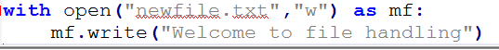
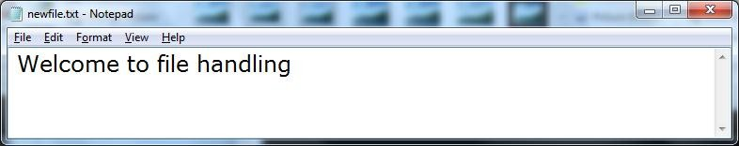
Example

Slide 8
Reading from File
To read from file python provide many functions like :
Filehandle.read([n]) : reads and return n bytes, if n is not specified it reads entire file.
Filehandle.readline([n]) : reads a line of input. If n is specified reads at most n bytes.
Filehandle.readlines(): reads all lines and returns them in a list

Slide 9
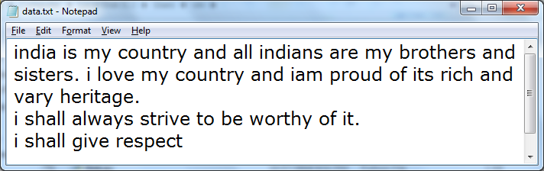
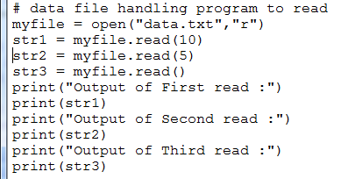
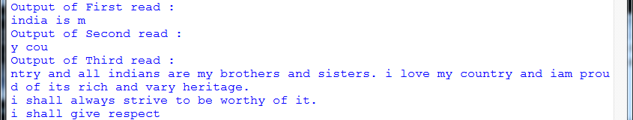
Example-1: read()

Slide 10
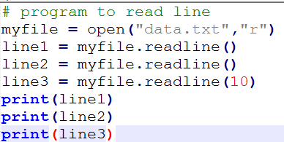
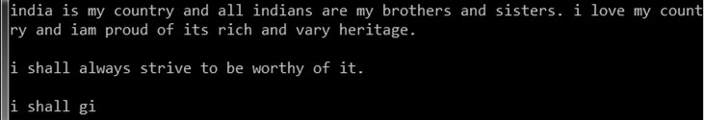
Example-2: readline()

Slide 11
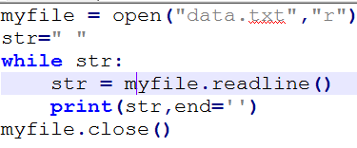
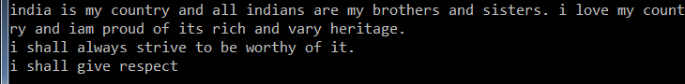
Example 3: Reading line by line using readline

Slide 12
Writing onto files
After read operation, let us take an example of how to write data to files. Python provides functions:
write ()
writelines()
The above functions are called by the file handle to write desired content.
Name | Syntax | Description
write() | Filehandle.write(str1) | Writes string str1 to file referenced by filehandle
Writelines() | Filehandle.writelines(L) | Writes all string in List L as lines to file referenced by filehandle.

Slide 13
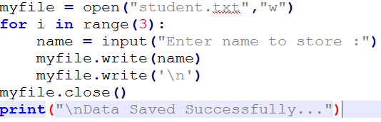
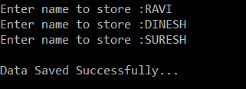
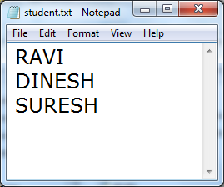
write() using “w” mode

Slide 14
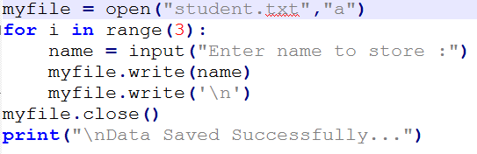
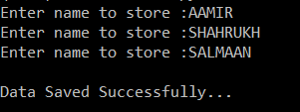
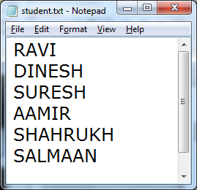
write() using “a” mode
Now we can observe that while writing data to file using “w” mode the previous content of existing file will be overwritten and new content will be saved.
If we want to add new data without overwriting the previous content then we should write using “a” mode i.e. append mode.

Slide 15
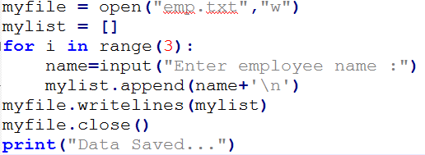
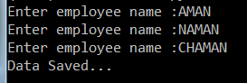
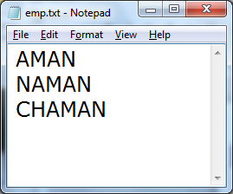
using writelines()

Slide 16
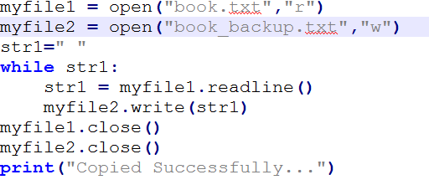

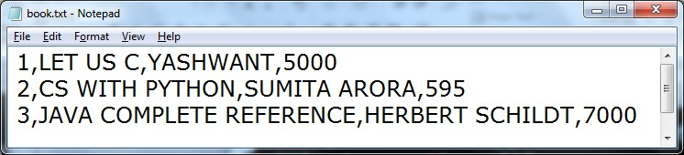
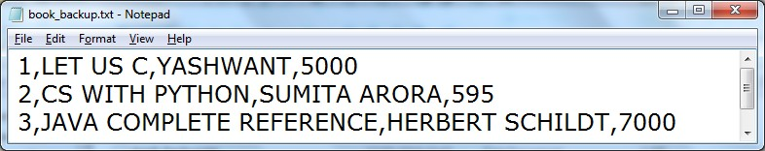
To copy the content of one file to another file

Slide 17
Removing whitespaces after reading from file
read() and readline() reads data from file and return it in the form of string and list respectively.
If you want to remove these characters you can use functions.
strip() : removes the given character from both ends.
lstrip() : removes given character from left end.
rstrip() : removes given character from right end.

Slide 18

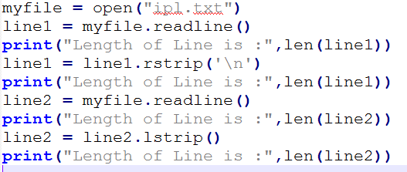
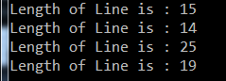
Example: strip(), lstrip(), rstrip()

Slide 19
What all operations can we do on file?
Renaming File
Syntax:
os.rename(current_file_name, new_file_name)
Deleting File
Syntax:
os.remove(filename)

Slide 20
Binary file operations
If we want to write a structure such as list or dictionary to a file and read it subsequently , we need to use the Python module pickle.
Pickling is the process of converting structure to a byte stream before writing to a file.
while reading the content of file a reverse process called Unpickling is used to convert the byte stream back to the original format.

Slide 21
Steps to perform binary file operations
First we need to import the module called pickle.
This module provides 2 main functions:
dump() : to write the object in file which is loaded in binary mode
Syntax : dump(object_to_write, filehandle)
load() : dumped data can be read from file using load().
i.e. it is used to read object from pickle file.
Syntax: object = load(filehandle)

Slide 22
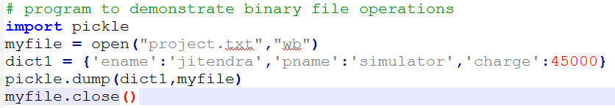
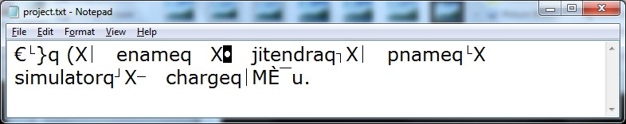
Example: dump()
See the content is some kind of encrypted format, and it is not in complete readable
form

Slide 23

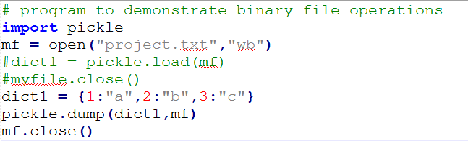
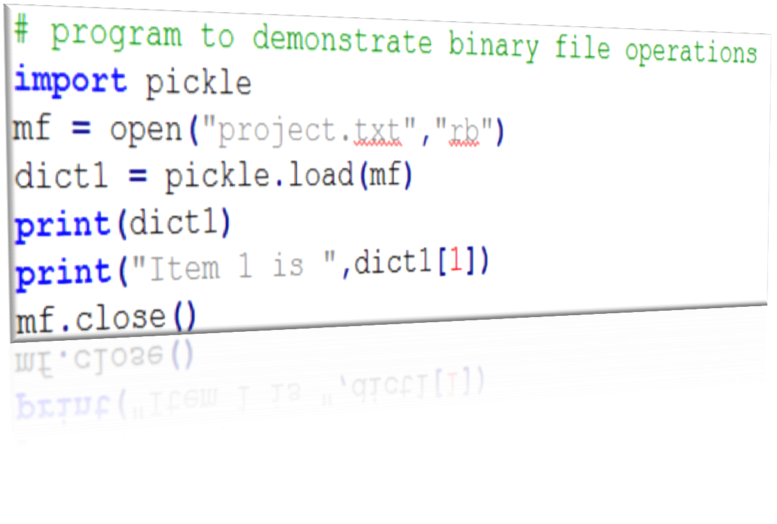
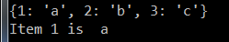
Example: load()

Slide 24



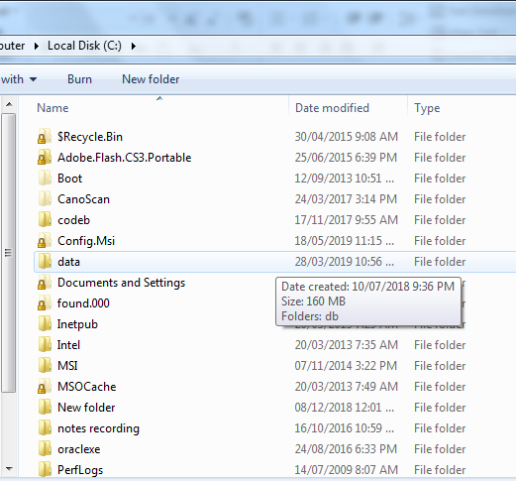

Absolute Vs Relative PATH
DRIVE
FOLDER

Slide 25
Absolute Path
Absolute path is the full address of any file or folder from the Drive.
Below is example of absolute path:
C:\Sridhar\2023\training_sessions\python_file_handling.ppt
Relative Path
Relative Path is the location of file/folder from the current folder.
To use Relative path special symbols are:
Single Dot ( . ) : single dot ( . ) refers to current folder.
Double Dot ( .. ) : double dot ( .. ) refers to parent folder
Backslash ( \ ) : first backslash before (.) and ( .. ) dot refers to ROOT folder.
of file

Slide 26
Reading and writing csv file in Python
CSV (stands for comma separated values) format is a commonly used data format used by spreadsheets.
The csv module in Python’s standard library presents classes and methods to perform read/write operations on CSV files.

Slide 27
writing csv file
import csv
persons=[('Lata',22,45),('Anil',21,56),('John',20,60)]
csvfile=open('persons.csv’, 'w', newline=‘’)
obj=csv.writer(csvfile)
for person in persons:
obj.writerow(person)
csvfile.close()
Reading csv file
import csv
csvfile=open('persons.csv’, 'r', newline=‘’) obj=csv.reader(csvfile)
for row in obj:
print (row)

Slide 28
Thank You

